Slide 1
Messages from last night
Developing good habits for team work, no woman is an island
Writing readable code with proper style
Java’s popularity, Hazelcast’s success relies on easy re-usability
A lot of practice (i.e. doing bonus projects) in programming

Slide 2
for ( init ; test ; step ) {
statements to be repeated
}
for (int i = 0; i <= 50; i++)
i=0
….
….
….
….
i=1
….
….
….
….
i=2
….
….
….
….
i=3
….
….
….
….
i=50
….
….
….
….
i=51
….
….
….
….
……..
i++
i++
What is the value of i after the for loop?
Sorry, i is dead ☹

Slide 3
Exercise: Reading for Statements
Describe the effect of each of the following for statements:
1.
for (int i = 1; i <= 10; i++)
2.
for (int i = 0; i < N; i++)
3.
for (int n = 99; n >= 1; n = n - 2)
4.
for (int x = 1; x <= 1024; x = x * 2)
Notes:
3

Slide 4
Keep The Balance:
I have a factory that runs with 100 people. Some people get paid 500 units/month, some 100 units/month, and some 5 units/month.
I pay 10000 units/month to my workers.
How many of the 100 receive 5 units/month?
Could you help me with a Java program?
Notes:
4
4

Slide 5
Comparing for and while
The for statement
for ( init ; test ; step ) {
statements to be repeated
}
is functionally equivalent to the following code using while:
init;
while ( test ) {
statements to be repeated
step;
}
Notes:
5

Slide 6
The if Statement
if (condition) {
statements to be executed if the condition is true
}
if (condition) {
statements to be executed if the condition is true
} else {
statements to be executed if the condition is false
}
We don’t write a condition there, the condition is just the inverse of the if condition
Notes:
6

Slide 7
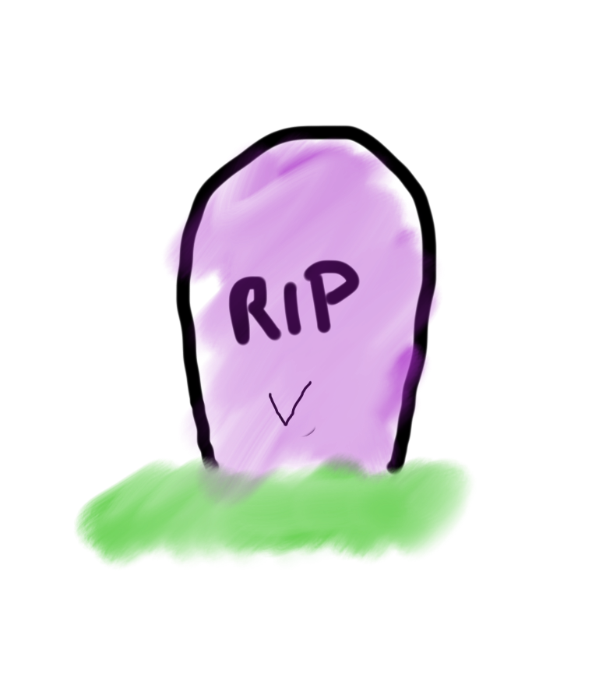
Declaration, assignment, update
{
….
int x = 5;
….
….
}
=
5
int x
Sorry, x exists, you cannot re-create it before it dies. Cloning not allowed!
int x = 7;

Slide 8
Declaration, assignment, update
{
….
int x = 5;
….
….
}
No error, but it does not update x! it computes value of x+2 and forgets it.
x +2;
Let’s grow x

Slide 9
Declaration, assignment, update
{
….
int x = 5;
….
….
}
Good! After this line x indeed has a value of the previous value + 2
x=x +2;
Let’s grow x
In Java = is not a mathematical equality operator, it is an assignment operator

Slide 10
Methods returning objects
Color Spectrum

Slide 11
private GRect getColoredSquare(int red,int green, int blue) {
GRect square=new GRect(STEP,STEP);
Color newColor=new Color(red%256,green%256,blue%256);
square.setColor(newColor);
square.setFilled(true);
return square;
}
The output is a colored rectangle

Slide 12
public class Spectrum extends GraphicsProgram {
public static final int APPLICATION_WIDTH = 256;
public static final int APPLICATION_HEIGHT = 256;
public static final int STEP = 5;
public void run() {
for(int x=0;x<getWidth();x=x+STEP) {
for(int y=0;y<getWidth();y=y+STEP) {
GRect point=getColoredSquare(x,y, 100);
add(point,x,y);
}
}
}
private GRect getColoredSquare(int red,int green, int blue) {
GRect square=new GRect(STEP,STEP);
Color newColor=new Color(red%256,green%256,blue%256);
square.setColor(newColor);
square.setFilled(true);
return square;
}
}

Slide 13
Methods calling other methods

Slide 14

Projects
Make Your Own - Written by You
Before you get started you must have your idea approved by one of the teachers! Think of a few, incase one is too hard or too easy.

Slide 15
http://cs106a.stanford.edu
CS 106A 2017 video lectures
CS 106A 2008 video lectures

Slide 16
https://sites.google.com/a/ku.edu.tr/comp130/

